Slide 1
The SIX Standards of Loss Prevention
How to bring greater profitability to your company through proven loss prevention strategies

Slide 2
The SIX Standards of loss prevention
Table of Contents | Page
Introduction | 3
Prevention | 4
Awareness | 6
Compliance | 9
Detection | 11
Investigation | 13
Resolution | 16
Conclusion | 18
Additional Resources | 19
Contact Information
The Integritus Group
info@theintegritusgroup.com
www.theintegritusgroup.com
© 2023 The Integritus Group, Inc.

Slide 3
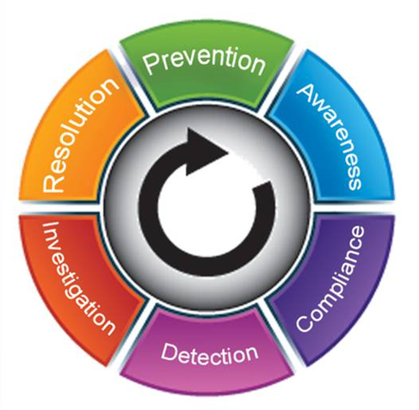
Introduction
With annual losses over $94 Billion, the retail industry is plagued with theft. Whether it be from external sources, such as shoplifting, or through internal employee theft, a retailer without an adequate loss prevention function will incur greater loss than a retailer who practices a well-structured approach to attacking loss.
A well-structured loss prevention function should include a program designed around six key Standards. These six individual, but symbiotic, standards provide an approach that will focus on the prevention, identification and resolution of loss. Embracing these standards within a loss prevention function(both structure and program) will provide any retailer the best opportunity to promote an environment of profitability and prevention.
These six standards as shown in the diagram include; Prevention, Awareness, Compliance, Detection, Investigation and Resolution. Formed as a circle moving clockwise, each standard has a relationship with the next. The process starts with and circles back to the primary standard and objective of any loss prevention program – Prevention. The overall goal is to include all of these standards within your function’s initiatives, resources and technologies.
As a philosophy, these standards should work in conjunction with a holistic approach to loss prevention. Thinking beyond theft and error, a strong loss prevention function should also focus on margin erosion, supply chain management and other areas that can cause profit loss.
6 Standards of Loss Prevention|© The Integritus Group. 2023

Slide 4
Prevention – The Primary Standard
It’s obvious that the objective of any loss prevention program should be the prevention of loss, which is why it is the first and most important of the six standards. From the very beginning, a program’s design should focus on prevention; processes, implementations, technologies and the use of resources.
Additionally, prevention should play a role within each of the remaining standards. As you will read, the elements of a solid LP program should include a means of measuring, analyzing and formulating strategies to prevent future loss. Even when dealing with the standards of detection and investigation, a good program has some form of regression analysis to determine or identify how the losses occurred and the methods of resolution so that measures can be assessed, developed or re-structured to prevent future losses.
There are two core elements found in well structured loss prevention programs.
Dedicated Loss Prevention Resources
Having dedicated resources (internal or outsourced) to develop, implement and maintain the overall program and its elements provides a retailer with a focused means of preventing loss, reducing shrink and increasing overall profitability. This dedication goes beyond “assigning” or “tasking” someone with the loss prevention responsibility, but actually dedicating resources to the development and execution of a program.
Creation and Implementation of Controls
Developing controls that focus on areas of the business that incur loss (point of sale, inventory control, cash control, safety, shoplifting, employee theft, etc.) will help establish proper policy and procedures to prevent loss.
6 Standards of Loss Prevention|© The Integritus Group 2023

Slide 5
Prevention – The Primary Standard
Loss caused by theft, error or margin erosion affect bottom line profitability. Retailers who begin with the core elements of an LP program and incorporate these standards into their initiatives establish a solid foundation for making loss prevention a driver of profitability.
Dedicating resources, whether internally resourced or outsourced, brings the skill, knowledge and attention to the concepts of loss prevention and the continued progression of a loss prevention function. The creation of policies, procedures and processes geared toward the holistic approach to loss prevention provides the greatest long-term opportunities to prevent loss and increase company profitability.
As this eBook continues to introduce the other
standards of loss prevention, always keep in
mind the primary standard of prevention.
Prevention is the driving force
behind the other standards of
loss prevention.
6 Standards of Loss Prevention|© The Integritus Group 2023

Slide 6
Awareness the 2nd Standard
Moving clockwise around the circle, Awareness is the next standard, closest to prevention. As a retailer develops preventative measures through policy, procedures and controls, the education of the workforce and the development of awareness will begin to spawn the concepts of loss prevention across the business.
If asked, most associates in a retail environment would state that they understand the aspects of loss prevention, how losses occur, and how to prevent theft and loss. Retailers should not assume or expect that their staff, management included, is familiar with loss prevention. Most industry studies and surveys show retail executives believe employee theft is the largest percentage of annual loss to a company (and we agree). Our experience has been when store level management and associates are asked this question the vast majority will respond that shoplifting or external theft is the main cause of loss within their individual location (and it can be based on the retail store). What might this tell you?
To successfully generate awareness to a workforce, retailers should ensure certain
elements to an effective loss prevention awareness program exist.
Develop a program with a variety of mediums through consistent and repetitive messaging
Materials should be written for all levels of the workforce not only for management or
specific roles within the business
Have a strategy that increases education and awareness of loss prevention concepts
6 Standards of Loss Prevention|© The Integritus Group 2023

Slide 7
Awareness
Simply providing materials to generate awareness is not enough. Gauging the level of understanding of the material must be a component of any awareness program. This can be obtained through various means including; store audits, meetings, store discussions, contests or other learning standards. Having some form of measuring the retention level helps to understand what works and what needs to be re-defined to generate the greatest level of awareness.
When it comes to generating awareness and educating staff, retailers should not shy away from discussing the concept of employee theft. Although it can be a difficult topic for some, retailers have found that talking to their staff about employee theft (how it is done, how it is detected, the responsibility of all associates to prevent it, etc.) provides a higher level of awareness and offers more of a deterrence than not discussing it with their associates.
Multiple learning formats
Without employee awareness you cannot expect your staff to know how to prevent loss or what to do when a situation arises.
6 Standards of Loss Prevention|© The Integritus Group 2023

Slide 8
Prevention through Awareness
Awareness through various programs and initiatives builds education, which leads to the aspects of deterrence, compliance (or known non-compliance thereof) and of course the primary standard; prevention.
Some examples of common tools used to educate associates and increase the prevention of loss through awareness include;
The development of an awareness program with materials easily accessible and located within each retail location. Materials can include; Interactive & Hybrid Print Campaigns, Digital Solutions, Mobile Content Delivery, etc.
The creation of an associate guidebook on loss prevention, detailing key policies, procedures, responsibilities and steps to deter theft and reduce shrink and loss. Such a book can be utilized for new hire on-boarding or individual training for specific roles and responsibilities.
In-store loss prevention presence ,whether its a scheduled or unscheduled visits by an auditor, investigator or other LP resource. Store visits show store associates that someone involved in loss prevention can visit at anytime. LP knowledge and the resolution of issues at store level helps to create a culture of awareness and can be a deterrent to future issues. Store visits also allow an opportunity for staff to ask questions to an LP professional on topics or areas of uncertainty.
Developing and maintaining an audit program for retail locations can assist in preventing future losses by highlighting compliance or procedural concerns as well as commend positive behavior and compliance. Having a structured and consistent audit program will ensure that policies and procedures are followed and the opportunities for loss are reduced.
6 Standards of Loss Prevention|© The Integritus Group 2023

Slide 9
Compliance the 3rd Standard
After Awareness comes the standard of Compliance. All businesses establish some form of policies, procedures and protocols designed to follow best practices. These practices assist in the sales, operations and merchandising of the retail location. They must also be developed to support the prevention of loss.
Many retailers have established policies and procedures to support the prevention of loss. Why is it then that they still experience loss due to theft or error? The answer is simple; most often when loss occurs, it is found that there was failure to comply with a specific policy or procedure.
Stressing compliance toward established policies and procedures and holding those accountable are important parts of a loss prevention program. Any associate’s ability (management included) to not follow or alter procedures will only open the door for a potential loss. Particularly those policies or procedures specifically created to prevent a loss.
Maintaining compliance within retail locations is always best served through auditing the various operating procedures and policies. These audits do not always require a large-scale visit or an audit that creates a detriment to the daily routines of store associates. Audits can come in all sizes and by several different names; audits, visits, checklists, etc.
A true loss prevention audit must focus on the factors associated with the prevention of loss rather than become diluted with other areas of the business.
An audit that includes store maintenance items or operations unrelated to loss will do very little to promote loss prevention. It is best to have separate audits, one for the various areas of the business and one for loss prevention.
Using separate audits emphasizes the importance of loss prevention and the approach to preventing an opportunity for loss through non-compliance.
6 Standards of Loss Prevention|© The Integritus Group 2023

Slide 10
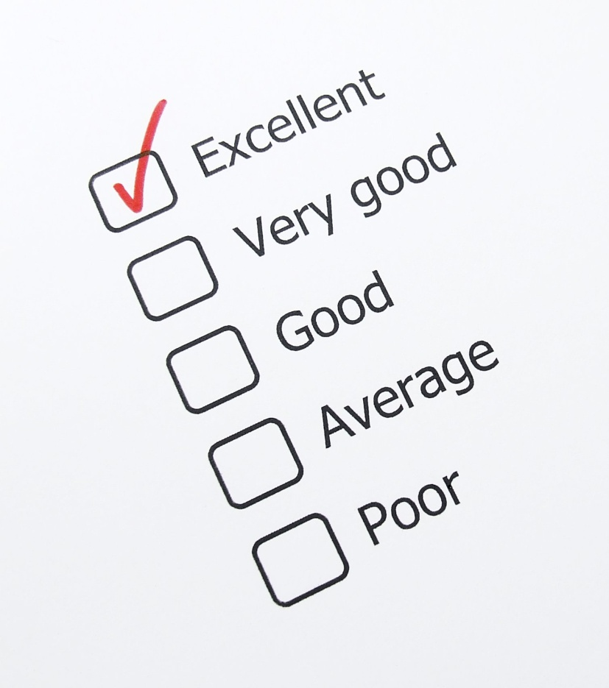
Prevention through Compliance
Stressing compliance within your loss prevention and operational programs brings a continued level of awareness to your associates. Through awareness, they learn how losses occur and how loss affects profitability. Through an understanding of policies, procedures and compliance checks, they learn that deviation from established company guidelines can result in loss.
Maintaining a program designed to review and report compliance
helps to promote a certain culture. Many speak of “a culture of
honesty” that focuses on the awareness to do the right thing.
Developing “a culture of compliance” will work toward a better store
and prevent the opportunities for loss to occur in the first place.
6 Standards of Loss Prevention|© The Integritus Group 2023

Slide 11
Detection the 4th Standard
Not all losses can be prevented. Theft will continue to happen, and errors will occur. Therefore, if a loss cannot be prevented, then it must be detected and resolved quickly to reduce any lost profits.
Today’s retail industry has many available technologies to help detect possible losses involving thefts and errors. These technologies provide the “visibility” to help quickly uncover issues. The use of technology, coupled with generating awareness about the technology, a retailer can create a level of deterrence against future thefts. Technology alone however is not a complete solution.
Detection still requires human intelligence and interaction. Tools such as exception-based reporting still require skilled individuals to analyze the data and develop potential cases. Programs that include audits and store visits can detect failures and non-compliance which lead to lost profitability. There are many areas where detection can assist the overall business even outside of theft.
EXAMPLE
Poor customer service can lead to INCREASED EXTERNAL THEFT AND LOST SALES
SOLUTION
Establish a mystery shopping program or remote video audit to detect poor customer service and change the behavior.
As loss prevention initiatives are developed, they must contain tasks, procedures and programs that can detect loss. Whether utilizing technology or human resources, the ability to quickly detect an actual or potential loss will allow for the efficient investigation and effective resolution of such issues. An undetected loss can easily compound and destroy the profitability of a single retail location within a short amount of time.
6 Standards of Loss Prevention|© The Integritus Group 2023

Slide 12
Prevention through Detection
Detection breeds a reactive response, as the loss may have already occurred. However, having established processes in place to easily detect losses will most certainly help to reduce any future occurrences of loss.
Today’s detection…
…begins tomorrow’s prevention.
6 Standards of Loss Prevention|© The Integritus Group 2023

Slide 13
Investigation the 5th Standard
Halfway around our circle is the standard of Investigation. Often this standard is more reactive than proactive; however, it is no less important than the other standards of loss prevention.
Most retailers see “investigation” as involving the collection of evidence, interviewing of associates, or the overall process to find someone involved in business abuse. Although the term investigation is often used in this sense, it is not entirely accurate. An auditor conducting an operational audit is in fact conducting an investigation to determine compliance or adherence to policies and procedures. A customer service shop is an investigation into the service and support provided to customers by salespersons.
Taking the term holistically, an investigation can be defined as an inquiry or
examination through a systematic process. This means that the investigative
process can be many parts of a loss prevention program, including an audit,
mystery shop or theft investigation. Although it is often the process of
determining a loss or business concern, the standard itself should have a
significant role within a loss prevention program.
6 Standards of Loss Prevention|© The Integritus Group 2023

Slide 14
Investigation
When it comes to addressing potential theft or loss, many retailers focus less than adequate resources on the investigation of issues and find that they continue to have losses without proper resolution. Having specific resources to conduct investigations not only increases the ability to discover or identify uncovered issues, but also reduce liabilities involving incidents of theft or personnel issues. Having qualified and skilled individuals conducting investigations also ensures that a non-bias, structured process of investigation will be performed.
Some areas of investigation within a loss prevention program include:
Store Theft Investigations (internal and external theft)
Organized Retail Crime Incidents
High Shrinkage or Target Store Markets
Point of Sale Data Analysis (data investigations)
Sexual Harassment or Human Resource Concerns
Policy & Procedure Compliance (through an Audit Program)
Customer Service or Comp Sales Analysis
Regulatory Compliance (Age Verification or Government Compliance Audits)
Mystery/Integrity Brand Compliance Shops
6 Standards of Loss Prevention|© The Integritus Group 2023

Slide 15
Prevention through Investigation
Like detection, the standard of investigation does not directly provide prevention.
Indirectly, conducting investigations into store issues does provide a sense of awareness. It also establishes a corporate culture that theft and loss is neither acceptable nor welcome in your business environment.
Failure to properly investigate issues can create a culture of acceptance and within this environment, internal theft and poor morale are more prevalent within the associate base.
6 Standards of Loss Prevention|© The Integritus Group 2023

Slide 16
Resolution the 6th Standard
Following the detection and investigation of any loss, every program should include a process for Resolution. As the last standard and closest to the first standard of prevention, resolution is where the reactive aspect of a loss prevention program starts to become proactive once again. Establishing a process for resolution will help to answer the questions of how to prevent future losses.
Resolution comes in many different forms depending on the type of loss and the overall investigation of such loss.
A retailer’s ability to resolve issues is co-dependent on their ability to properly investigate the issues. Those who are not focused on establishing good investigative solutions (whether they include audits, reviews or theft interviews,) will see decreased results in their overall resolution of loss. Taking an investigation to the point where it is completely resolved is the best way to uncover the root cause of the issue and how it has affected your business and created a loss.
For those investigations involving theft, the resolution can be the identification of culprits involved, admissions of theft and the establishment of restitution and civil recovery processes.
For losses identified as training or compliance,
resolution can be the review and alterations of
existing policies and procedures, and/or the establishment of new policies.
6 Standards of Loss Prevention|© The Integritus Group 2023

Slide 17
Prevention through Resolution
Although prevention is not a direct benefit of resolving issues, establishing processes that include closure and complete review of issues will help to finalize existing concerns and prevent future losses.
Some common forms of resolution can include:
A policy review program to enhance programs where failures are found.
Training & Awareness Programs to educate associates on known losses and to prevent future opportunities of loss.
Development of new reports or queries of an exception-based reporting tool to more quickly identify potential loss.
A restitution and civil recovery program to retrieve losses due to theft.
It is surprising to see how many retailers will go through the investigative process and believe that it is completed at the point the admission is obtained without pursuing restitution or a review of how the theft occurred in the first place.
Only through an established review and resolution process can a retailer continue to develop, enhance, and modify their programs, systems, policies and other aspects of their business. Remember; the goal of resolution is to remove opportunities for future loss.
6 Standards of Loss Prevention|© The Integritus Group 2023

Slide 18
The Principal Conclusion
Reviewing the Six Standards of Loss Prevention, it has become evident how each of them plays great importance in building and maintaining a solid loss prevention program.
As individual standards, they each provide elements toward reducing shrinkage, margin loss and costs.
Collectively working in tandem, they provide the key standards of a loss prevention program and a solid foundation against loss.
6 Standards of Loss Prevention|© The Integritus Group 2023

Slide 19
About The Integritus Group
The Integritus Group, Inc. is a leader in loss prevention outsource solutions and services across the United States and Canada.
The Integritus Group helps companies build comprehensive and proactive loss prevention programs that deliver results. The Integritus Group is more than just trusted experts and consultants; We provide the field and corporate personnel that build and execute loss prevention services and solutions.
Our value proposition is simple. We provide our clients with:
Proven loss prevention strategies and results
Expert field personnel for a successful loss prevention program
The ability to quickly develop, implement and execute a new loss prevention function (complete outsourced model)
Supplement an existing loss prevention department with additional resources that are less costly then adding headcount.
Cost effective programs
The Integritus Group has designed and executed programs with results that
exceed expectations.
We invite you to learn more about The Integritus Group and the benefits of our expert solutions
and services.
VISIT OUR WEBSITE
6 Standards of Loss Prevention|© The Integritus Group 2023

Slide 20
An educational presentation by
© 2023 The Integritus Group, Inc.

