Slide 1
5 Steps to Improving High Loss Locations
An E-Book developed to provide information on the development, execution and analysis of a Target Store Program
© 2023 The Integritus Group, Inc.

Slide 2
Introduction
We have three goals for our presentation.
Goal 1 - explain why it is important for every company to have an established program that can be enacted when a location is found to have high inventory losses.
Goal 2 - we will discuss 5 key steps that our company utilizes to successfully develop and execute a target store program,
Goal 3 - Most importantly, we will provide some best practices to assist in uncovering the root causes of existing loss while preventing current high loss locations from being future problems.
Why the need for an established target store or high loss location Program
Discuss the 5 key steps to developing a program
How to act proactively in preventing and controlling future high loss locations

Slide 3
Target Store Program Defined
Over and beyond existing program elements Audits / Store Visits
Loss Prevention Specific Goal: Find and Resolve Root Cause of Loss
Store Specific Each store looked at individually
When we review a company’s inventory loss, it is common to find that a small percentage of locations are responsible for most of the losses. We understand that by properly reducing the loss in these locations, we can have the largest impact to a company’s overall profitability.
We call these locations, Target Stores.
PLEASE NOTE: When we mention a “target store” it means we are discussing a single location, which could represent a retail, restaurant, grocery or convenience store. We use this term to mean a location, not toward any specific retail segment or vertical.
A Target Store Program is one that is over and beyond an existing Loss Prevention program. A current program may include audits, store visits and other elements like training and awareness, data analysis, investigations, etc. These initiatives should be used in all locations, but with a target store program, the things we are going to talk about should be done beyond your existing initiatives.
The goal is to look at each store individually and determine the reason for the loss, resolve any issues and to correct the “why” the losses occurred, all so they do not happen again. A target program is very specific in its focus for each individual store.

Slide 4
The Five Steps
These are the 5 steps we will be discussing in detail throughout this presentation. We will be providing an overview as well as key details for each step along the way. We will also provide some caution areas and some successful ideas to remember.
Identity
Develop
Execute
Measure
Educate

Slide 5
Step 1: Identity
The first step is identifying your target stores.
What determines a target location?
How many target locations should I have?
How do we communicate this classification of a target location?

Slide 6
Determining a Target Location
For many, the selection process is usually based on loss. Losses that are more than likely uncovered during a physical inventory. These losses are calculated as a shrink percentage, Food cost, margin percentage, or cost of good sold.
It is always best to look at multiple factors when determining which locations should be target stores. Factors such as inventory history, known incidents or previous issues of loss are a couple of these factors.
You should also look at your data in different ways. Our caution box highlights one example; Shrink percentage versus shrink dollars.
We have seen companies who have not placed locations on a target store program because their shrink percentage was considered less compared to other locations. However, looking at their dollars lost, these locations were much higher, but sales had hidden the true amount of shrinkage.
We have seen when companies placed such a location on a target store program and reduced the dollars lost, it showed a larger contribution to the overall company profitability than targeting a higher shrink, lower sales location.
Shrink % vs. Shrink $
Don’t rely solely on shrink percentage to determine target locations.
You may have higher loss locations based on Shrink $

Slide 7
Determining a Target Location(cont)
Another thing to look at is how locations compare to similar locations. These locations can be in your company, like other mall or strip center locations, or across the industry using surveys, studies or groups you may belong to.
Finally, this would be a good time to talk to other departments in helping to determine target locations. Don’t do this in a vacuum. Throughout this presentation we will talk about the need for partnerships and the beginning is the best place to start.
Inventory Results
Shrink / Food Cost / Margin / Cost of Good Sold
Location History
Inventory History/ Prior Issues or Incidents
Benchmarking
Internal Comparison / Industry & Geographical Comparisons
Partnership Involving other departments with vested interest (operations, finance, merchandising etc.) will provide not only better teamwork but collective ownership in achieving results.

Slide 8
Determining How Many
Once you have determined who should be a target store, you need to look at that list to determine realistic expectations. Sometimes, resource restrictions, which can include people or budget dollars may make it unreasonable to focus on all the locations that have been classified initially as targets.
Look at your list and if necessary, set tiers. We have a client who breaks their locations into a stoplight of Green, Yellow and Red. Red is an absolute target store, yellow are alternates and green are not problem locations.
As they further develop their program, they focus on the Red locations, keeping their yellow locations in mind. If they are visiting an area and a yellow store is nearby, they would visit it if time allows.
Some words of caution: Don’t pick a straight shrink or margin % of stores or a specific number of locations. It could dilute your efforts trying to get to so many locations completed in a certain amount of time. Although a general rule of thumb is 20% of your locations, how many you can really support depends on your available resources more than a straight number of locations.
If resources are a concern, think outside the box. Could other departments or resources in Store Operations or Internal Audit assist you in executing a program?
Or do you look outside to audit companies with unbiased opinions to provide additional resources to help supplement existing resources.

Slide 9
Determining How Many (cont)
Set Realistic Expectations
Understand your Resource Potential
Staff Resources / Budget Dollars
Determine Number of Locations
Set Tiers if necessary
Priority Locations v. Alternative Locations
Too Many = Too Little
Not wise to pick a number or straight %
Too many can dilute your efforts
RULE OF THUMB: 20% of Stores
(We have almost always found that 20% of your locations cause the company 80% of their problems)
Resources
Think outside “your box”
Other Departments (Operations, Internal Audit, Merchandising, Finance)
Outside Resources

Slide 10
You Have Been Selected
We will talk about communication in greater details throughout this presentation but now is the time to think about how you will communicate the selection to those locations.
Plan to include all appropriate resources, including Operations at various levels, store management and even down to all associates.
Make sure that communication remains positive. Set understandings that input, and assistance is appreciated, accepted and welcomed.
Don’t make being a target store a punishment. Yes, it is a serious issue that needs to be resolved but let them know how they can help.
An example was one company who drafted a Declaration of Shrink, which was a large poster that looked like the Declaration of Independence and had all store associates sign it and post it in each location. They even had the President of the company’s signature on the poster in a fashion similar to John Hancock. Corny, maybe…effective, yes.
It all starts with getting everybody onboard and accepting of what needs to happen to improve their results.
Communicate selection to Operations
Set Requirements and Expectations
At Store Management Level (DM, Store Manager)
All Store level associates
Set expectation that it can be resolved
Will require input and assistance from everyone
Don’t Punish Them
To resolve a high loss location, you will require the assistance (and support) of all associates.
Don’t make being a target store a punishment rather let them know they can help.

Slide 11
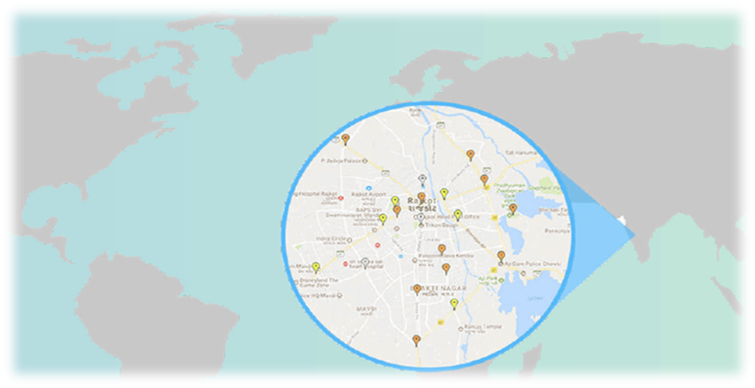
Step 2: Develop
Now that you have identified which stores will be the “target” locations, you need to start developing the specific program for these stores to follow.
This includes using Data to analyze what has been happening, developing the actual program elements and setting up schedules and timelines to execute the program properly.
Determine Data Points & Analysis
Create Specific Program Elements
Planning & Timeline

Slide 12
Data Points and Analysis
Start the plan development by looking at what information is currently available or needed to report on the store’s day to day operation. This information should be geared at what may negatively influence their performance and contribute to a higher shrink. It is recommended to generate reporting across all stores to easily identify where the specific “target” store falls in comparison to the average or “norm”. This reporting will establish “store trending” that can be used to determine when a “red flag” exits in a “target” or even a “non-target store”.
For this review, you should be looking across your various tools; Exception based Reporting or POS Reports, Sales Audit reporting, Inventory Control, etc.
Keep in mind this reporting usually comes from a variety of different sources and may need to be created if not already in existence. Attempt to include information covering the prior physical inventory period for the best view of what was happening when the higher loss occurred. Although this may be somewhat of a lengthy process, the data gathered here will be crucial in identifying the areas to address when creating the “target” store’s plan.
Be cautious of getting caught up with any global issues that may be discovered as part of the analysis. These issues may not be easily fixed and may be too time consuming to address at this time.
Store Analysis- Known Issues / Inventory History / SKU & Item Loss Turnover / Employment
Transaction Analysis- SRA’s (sales reducing activities) / Non-inventory Loss
Physical Security Review- Current equipment / Reported Issues

Slide 13
Determine Program Elements
Our experience and recent studies has shown that multiple visits to each location has decreased shrink and improved inventory results more than a “one and done” target program. With this being said, what constitutes a visit?
The main “visit” to a target store would be considered an audit. This is the primary tool used to measure the store’s compliance to operational procedures. Other types of visits may be designed to address other elements that are defined within the target program.
The goal may be to partially review the target program, determine the progress of an Action Plan, conduct general awareness discussions, provide a simple check-in with store associates or a combination of some or all of the above.
The length of an audit or visit can be determined based on what you are attempting to accomplish and by the anticipated resources being used to conduct these visits.
The goal of an audit or visit should be primarily to identify anything currently contributing to the higher shrink and the prevention of future losses. These activities should be based on the “target” plan elements that have been established globally and store specifically.
Audits - The Primary Element of a Target Store Program Determines baseline for how store is operating
Store Stop-Ins & Additional Visits - Awareness & Check-ins
Action Plans - Structure action plans to be specific

Slide 14
Determine Program Elements(cont)
Be cautious if involving other departments in determining the program elements as the focus can easily be watered down when everyone wants to add what is important to them. Sometimes these items have little or no affect on improving the store’s shrink results.
The Action Plan will be the main document used to guide the store in what needs to be accomplished to properly address and correct issues identified as causing high shrink.
The plan should be specific to the store, realistic and those responsible need to be accountable for its completion.
It is a good idea to create an instructional guide to support the requirements of an audit or any variation of a visit. This will provide consistency in how the audit and visits are performed and reported by anyone assigned.
Remember why you are there
When developing your target elements like an audit, remember to keep focused on shrink improvement and inventory loss. Don’t get caught up in developing a standard audit. program.
Program Guide
Create a guide to help those who will be conducting your program. This guide should bring consistency, accuracy and focus to your program.

Slide 15
Determine Program Elements(cont)
Partner with store associates and management in an effort to further determine how the high shrink was caused in the “target” store. Attempt to learn “why” each associate believes the store has a higher shrink result. This will allow you insight into the day-to-day activities of store operations that you may not have known otherwise. Although the store associates and management “believe” their losses were caused by various reasons, they may not always be correct as they do not see the entire picture.
Be cautious when conducting any interviews and discussions as the associate will not elaborate on a question where the response is a simple yes or no. It is a good idea to determine the specific questions to be asked after considering any pre-work analysis and the results of the current audit or visit.
Never ask Yes or No Questions
When holding discussions with associates, ask open ended questions. Let them do the talking, as much as they want to talk.
Every Store is Unique
Prepare to have individual conversations, training and education for each store location. Associates in each store may also require specific individual training or education.

Slide 16
Determine Program Elements (cont)
You should purposely design the target program to conduct the audit first and speak with store associates afterwards. This process will generate additional information and data about how the store is currently operating and be used in the discussions to follow.
Some basic Loss Prevention education and awareness should be added to the program to be reviewed when an audit or visit is conducted. This information would be high level items such as how to handle shoplifting situations, unruly customers, report suspicious activity, understand shrink and how it is caused, internal checks and balances to name a few.
These items can all be tested a series of discussion questions at an audit or visit. The auditor should be prepared to teach and train the associates, as necessary.
Review the physical security measures for the “target” locations and start thinking about what additional they may need, if anything. The effectiveness of these measures should be evaluated as part of the audit or visit.
Audits/ Management Discussions - Plan on talking to store associates, Initial discussions with Operations Management
Education & Awareness - Develop an education element for associates
Physical Security Assessments - Does each location have appropriate resources

Slide 17
Planning and Timeline
It is important to decide how often visits will occur in the “target” stores and who will be conducting these visits. The goal would be to spread the available resources, specifically the visits and staffing, over the next quarter or physical inventory period to get the “best bang for the buck”. A schedule should be formed to note these specifics so everyone, except for the stores, who is involved will know the plan.
Make sure anyone selected to be involved in performing an audit or visit has been properly trained before conducting their first activity. Written documentation of the process flow, what should be reviewed and how non-compliance issues will be noted will avoid leaving any items open for interpretation.
Be cautious when scheduling target locations to make sure any one person is not overloaded. The primary concern would be for the District Manager who has a high number of target stores would not be easily manageable without outside help.
It is a good idea to review upcoming business requirements that can affect resource availability or allowing access into a location. Activities such as “blackout dates”, seasonal sales periods, corporate or field meetings, remodels and new store openings are a few examples of how resources can quickly be impacted. Plan ahead.
This is the last step before executing your program. Make certain that you once again have the right resources, everyone prepared to execute and understand how the program is going to work.

Slide 18
Planning and Timeline (cont)
Develop a Schedule
Coordinate assignments and responsibilities
Establish data-driven timelines
Communicate Schedule with Appropriate Personnel
Coordinate schedule and assignments
Train Additional Resources
Have written guidelines
Execution Overload
Make certain to look over the schedule and locations to caution against overloading an individual DM, LP or other individual (too many locations in their area). You may have to solicit additional resources or change schedules.
Know Your Business
Before kicking off your program is there anything in your business schedule that may prevent completing your program in the proposed timeline?

Slide 19
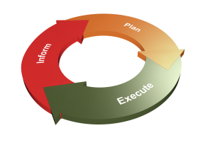
Step 3: Execution
The third step is the actual execution of your target program. This is where all your planning and pre-work will pay off.
Pre-visit Data Review
Store Visits & Discussions
Actions Plan & Follow Up

Slide 20
Before You Enter
Before walking into your first location, it is essential to be armed with as much information as possible. All pertinent data, as previously noted, should have already been requested and reviewed.
It is a good idea to discuss the information with Operations / Loss Prevention before entering store in case additional support is required. This preparation should have allowed the time in advance to prepare questions on any exceptions in the data.
Be cautious to confirm the accuracy of your data by comparing it with the actual paperwork on-hand. All findings should be discussed with management for any reasonable explanations.
A properly developed audit program will provide as much pre-visit information as possible. Although the initial target store program will be conducted in a detailed fashion, it is always best to have insight into what you may need to concentrate on prior to visiting your location.
Initial discussions with operations and management may also help to provide some first look information. There may have been documented training issues, compliance programs or possibly a theft issue. These discussions will of course continue during your visit and afterwards as you develop your action plan, follow up and finally results.
Review Your Data - Store Specific analysis of your data findings
Provide Data findings to on-site assessor - Provide specifics to be reviewed
Expect confirmation of data findings - Establish proper response to data analysis

Slide 21
Before You Enter (cont)
Is Your Data Accurate?
Go into your locations looking to determine if data is accurate. Remember lack of data doesn’t mean something isn’t happening.
(No known losses could mean not following known loss policy)
Pre-visit Data Discussion
You may want to have conversations with key personnel (DM, RM, LP, etc.) about your data findings prior to your visit. See if they can provide any additional information.

Slide 22
Conducting Your Visits
The main purpose of conducting an audit or visit to a “target” store is to identify “where” the losses are occurring and to help prevent them from occurring again in the future. The auditor should keep their “eyes” and “ears” open during the audit or visit. Root causes to losses may arise at any time and may not always be from the answer to a specific question asked.
This process of performing the audit or visit is not an easy task if the store associates view the audit or visit as a negative experience or do not understand the goal of the auditor. Be cautious of not making it an “us against them” situation. Preconceived notions of what the audit or visit will entail, or previous “bad” experiences may adversely influence the visit.
The auditor should be partnering / consulting with the store to explain the process and goals of the program from the start. Essentially, the overall goal of shrink reduction is the same for the store as it is for the auditor. The sooner the store understands this, the easier and more productive the audit or visit will become.
It is a good idea to fully explain to the associates how being non-compliant to a requirement on the audit or visit can negatively affect the store’s shrink results. Often times the associates do not understand the issue and its impact and therefore cannot or will not correct the issue. Providing these answers should positively affect the outcome
Compliance - Determine Operational Compliance
Inventory Loss - Seek to uncover potential root causes of loss
Include Training as part of your visits - Don’t make it only a negative experience

Slide 23
Conducting Your Visits (cont)
Us vs. Them
Any store visit should not be a “corporate v. stores” or “us v. them” approach. Use every store visit, target store visit included, as a training visit with your stores. Commend them as much as you need to correct them.
Never leave a store broken in moral
Access to Educate
Learn the weaknesses of each location through your visits. Address the cause and effect of these weaknesses so associates will understand how it affects the store’s performance

Slide 24
Discussion and Interviews
Use what you have learned from your audit, visit and analysis to determine the scope of your discussions and interviews with associates. As mentioned earlier, always ask open ended questions to solicit the most feedback. On occasion, ask questions that you know the answer to determine a level of honesty or understanding with each associate.
Ask each associate / member of management what specific actions they believe are causing the elevated shrink in the store. This will probably involve more in-depth questions based on what each associate notes as the cause if not clearly defined.
It is important each store associate / manager feels part of the process and has contributed to the overall solution.
Be cautious if an associate is showing signs of dishonesty during this non-accusatory discussion. The auditor may or may not be qualified to conduct a theft interview. Additional support would be necessary at this time, which may delay a formal interview. Think about how this situation would be handled in advance and have a plan ready to go.
Associate/ Management - Focus: Information Gathering & Insight Non-accusatory
Seek Potential Solutions - Ask for improvements and suggestions
Determine where they think losses occur - Everyone has an idea of how losses occur

Slide 25
Discussion and Interviews (cont)
Is There Dishonesty?
If an individual during an interview shows possible signs of dishonesty, then it would be appropriate to conduct a theft interview. Be cautious, however, to have the right person interviewing for potential theft.
Get Employee Buy-in
Employees are your day to day, front line people when it comes to loss prevention. Gaining their buy-in is of great importance to having a better performing location

Slide 26
Before You Leave
At the conclusion of a “target” audit, the results should be reviewed with the manager and district manager, if present. This is the time for the store manager and/or district manager to ask questions about the findings and agree upon the results.
An Action Plan is discussed and created to specifically address each area of weakness identified from the audit. This plan should note the noncompliant items, specific actions to correct, realistic time frames and who would be responsible for each item’s completion. Each item on this plan should be agreed upon by all parties before the document is signed off and implemented.
If for some reason the district manager could not be present when the action plan is created, attempt to conduct a conference call or schedule another time to discuss the plan. It is important to consider their thoughts and opinions on the specific actions noted when finalizing the plan. The district manager must be in agreement with the plan and have buy-in.
Develop Action Plan - An Actual Action Plan that is Store Specific
Discuss with Management - Ask for improvements and suggestions
Determine Follow-up - Everyone has an idea of how losses occur

Slide 27
Before You Leave(cont)
It is a good “best practice” to post this plan so all store associates can view the actions required and monitor its progress. A weekly status update on the plan should be communicated to all associates through in store meetings or bulletin board postings. All due dates for completion should be monitored weekly by store management and reported to the district manager and the corporate office for review.
Future visits should focus on the progress achieved on the Action Plan and to make certain the program requirements are still in compliance. This would be the time to adjust the plan or add additional items, as necessary.
Don’t Write It & Forget It
Too often we have seen action plans written and not followed up. Set actual and exact dates and expectations with action plans, including who will follow up and how everyone is provided updates.
Partner Not Present
If DM, RM or key persons are not present during the visits, set up ahead of time a call to discuss outcome as well as means of getting action plan to them. Don’t just email without explanation. ALL executive leadership needs to be reviewing the actions plans on store visits- If it’s important to them then the stores will make it a priority.

Slide 28
Step 4: Measuring Results
The fourth step is to begin deciphering your visit results to determine the root cause of your high losses. The act of measuring your results and determining the “how” and “why” losses have occurred will allow you to improve your results and follow up to ensure losses do not happen in the future.
Deciphering Root Causes of Loss
Improvements & Follow Up Results

Slide 29
Root Causes of Loss
As you execute a target program in each location, the root causes of loss should begin to appear. These causes can be based on one or several reasons;
If potential employee theft is uncovered, then a structured internal investigation would be necessary. This investigation should be conducted by those skilled in the process of investigating loss and able to conduct proper interviews to solicit potential confessions of theft.
If it shows that external theft, like shoplifting is an issue, then perhaps additional security equipment may be needed or better training on customer service to deter shoplifting.
It may also require additional training on compliance with security equipment such as; EAS tagging, CCTV system usage or other external theft preventions.
Often, even with other causes of loss, most target store locations do have lacking compliance to policies and procedures. This is where your training and education phase will help to highlight deficiencies.
Other areas could be systemic issues, which in many cases would cause global concerns or it is possible that a bad inventory occurred in which case you may want to schedule another inventory in that location or perform cycle counts.
Theft - Internal Investigations as necessary- Additional Equipment to prevent loss
Compliance Failure to follow policies and procedures
Systemic Issues - Systems not providing accurate data of results
Bad Inventory - Sometimes a bad inventory occurs

Slide 30
Measuring Improvement
Whatever you find to be the causes of high loss in each location you want to make certain you put together a process for measuring improvement. Your action plans from your visits should be the basis of your follow up.
Schedule and conduct planned checkpoints and milestones, which could be visits, phone calls or status emails with the store and operations.
Hold training meetings and follow up discussions to ensure retention with all associates.
If you can, conduct an inventory prior to the company next planned inventory to check improvement.
If you cannot conduct a full inventory set up a cycle count program to measure potential loss in key areas. This will help you to get a good gage on your loss prevention efforts.
Talk to other corporate departments to see if there have been less issues with your target locations. Has there been a decrease in issues with inventory control or sales audit? Less turnover in HR?
Planned Checkpoints and Milestones - Program execution should “see results” happening
Training Meetings - Conduct initial training meting and follow up
Additional Inventory - Doesn’t have to be full inventory (between inventories), Cycle Count program to measure potential loss improvement
Corporate-based Improvements - Fewer issues with Inventory Control, Sales Audits, etc.

Slide 31
Step 5: Education
Finally, we come to Step 5 which is educating your company and each individual store on what they need to do to prevent future loss. Like many other elements of this program, education should be viewed both globally and individually.
Company Wide Education
Individual Store Education

Slide 32
Company Wide Education
What we have learned from creating the “target” store program now comes full circle.
There has probably been areas where deficiencies were noted from a global standpoint that now need to be addressed, corrected and communicated to all stores. Some of these areas may be resolved through a simple policy and procedural change and others may be somewhat more complex.
Prioritize these issues based on their potential contribution to shrink and attempt to resolve them in that particular order. Use whatever available data is available to support the reason for the change in an effort to elevate the issue for resolution. This process will be a continuing cycle as the program moves forward and as the issues identified change.
Remember to review the documents used within your “target” program as they may need to be updated to reflect these changes.
Revised Policies and Procedures - Properly alter, create and disseminate information, Follow up to ensure proper understanding and compliance
Global Physical Security Issues- New equipment required - Policy and procedure changes or reinforcement
Systemic Issues - Correct any found systemic issues - Train or re-train in how to properly use system changes

Slide 33
Store Specific Education
There will be an on-going need for the stores to receive additional awareness and education in the effort towards shrink reduction. This may be accomplished through many different methods such as newsletters, conference calls, in store meetings, a daily/weekly shrink topic , possibly at the time of a visit, etc. The shrink impact will be greater if the associates / management understand what is causing the shrink in their location and how to limit or prevent it in the future.
The store’s progress on their specific Action Plan and compliance to the program’s requirements should always be the main focus while the store is on a “target” program. This can and should be measured / evaluated at any time during the process. It is always a good “best practice” to schedule time frames when progress should be measured to make certain the store is on the right track with their efforts. Consider the date of the next physical inventory for the store and schedule these “follow up” audits and visits accordingly
Continued Education - Continued store visits - Regularly scheduled calls - Specific awareness materials
Continued Measurement - Implement Self Audits- Continued Follow up by DM/ Operations- Loss Prevention

Slide 34
Recap: Goal #1
Here is a recap of our goals to review what we have discussed.
To properly reduce your high loss locations, it is best to have a developed target program ready to be enacted once it is determined that a location has experienced high loss.
Remember, a structured target store program is one that is beyond your normal operational and loss prevention programs.
Focus on determining how and why losses occurred, recover any potential losses and prevent future inventory loss. Do not “muddy” a target store program with non-loss related elements.
Determining the right locations that will have the greatest impact to the company overall and make sure that before you execute you have the proper resources available to conduct the program.
Establish a Structured Target or High Loss Location Program
Beyond normal operational or loss prevention programs
Focused on finding reasons for inventory loss and preventing future inventory loss
Determine the right locations that when corrected will have the greatest impact to profitability
Resources play a large role in the success of a target store program (personnel and budget)
How many locations can be included
How many visits/touches can be done

Slide 35
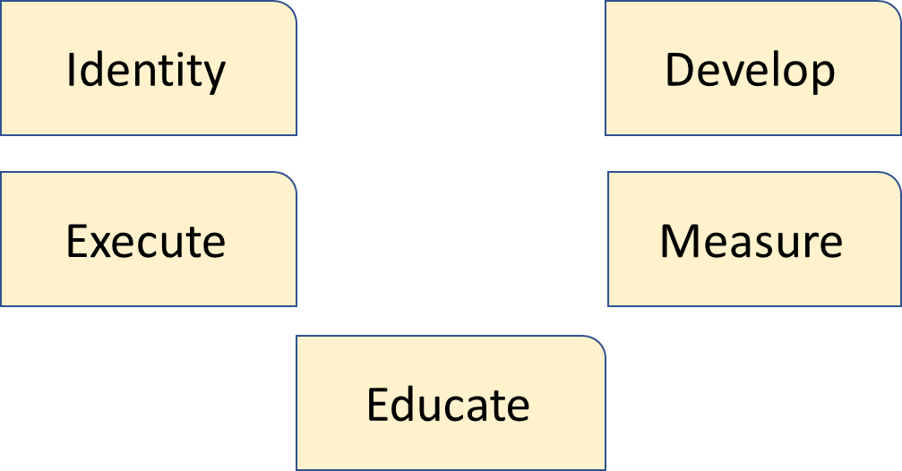
Recap: Goal #2
Goal number 2 was to introduce and discuss the 5 steps of developing and executing a good target store program.
These are the steps we have developed over the years working within/with retail companies with proven success in various geographical environments and across multiple verticals.
We can tell you that over the years working within/with retail companies across multiple verticals, our target store results have high double-digit percentage reductions in loss, most within a single inventory period as short as within a 6-month cycle.
There is a lot involved in these 5 steps and with proper planning, resource allocation and execution they will provide you with great results.

Slide 36
Recap: Goal #3
Goal #3 was how to act proactively in preventing and controlling future high loss locations.
This program contains all the elements to help identify stores who may be a potentially future high shrink location. It does include what can be done globally as well as specifically to address the main contributing factors before the problem increases or becomes out of control.
The key to being “pro-active” is to review all relevant data, identified earlier in this discussion, on an on-going basis and not just when physical inventory results are posted. This may take some time to build the necessary reports, but the trends you see may generate the “red flags” in advance. These efforts should have a positive impact on the overall shrink results.
Act on preventing and controlling future high loss locations
Understand each location is unique and store-specific
Focus on changing the behavior of associates and make them part of the solution
Program cannot be a “one-visit” initiative
Standard program should include proactive approach to loss prevention
Cycle Counts
Regular Audit Program
Associate Training, Education & Awareness

Slide 37
About The Integritus Group
The Integritus Group, Inc. is a leader in loss prevention outsource solutions and services across the United States and Canada.
The Integritus Group helps companies build comprehensive and proactive loss prevention programs that deliver results. The Integritus Group is more than just trusted experts and consultants; We provide the field and corporate personnel that build and execute loss prevention services and solutions.
Our value proposition is simple. We provide our clients with:
Proven loss prevention strategies and results
Expert field personnel for a successful loss prevention program
The ability to quickly develop, implement and execute a new loss prevention function (complete outsourced model)
Supplement an existing loss prevention department with additional resources that are less costly than adding headcount.
Cost effective programs
No long term contracts
The Integritus Group has designed and executed programs with results that exceed expectations.
We invite you to learn more about The Integritus Group and the benefits of our expert solutions
and services.
VISIT OUR WEBSITE

