Slide 1
5 Ingredients of a Food Service Loss Prevention Program
A well-balanced recipe for your Food Service Loss Prevention Program

Slide 2
Overview
“A good plan today is better than a perfect plan tomorrow”
A good loss prevention (LP) program takes more than a day to develop but should not take long if you have the right elements. This approach allows you to develop a program based on specific categories; each one a critical
component in reducing loss in a food service environment.
Here are three things to think about when developing a loss prevention program using this 5 Ingredient approach.
Categorization will provide a clear picture of the components, helps to determine the best starting point and will allow you to see any missing or lacking components in your existing program.
Use your current practices as a guide to establish new goals and timelines for the development and execution of new components.
Developing a program does not have to be linear. If you learn how each component works toward your goal, you can execute various programs simultaneously.

Slide 3
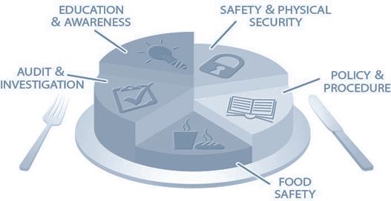
The 5 Ingredients
“A well-balanced recipe for your loss prevention program”
A good loss prevention program consists of certain “ingredients”, that when blended together according to a specific “recipe”, will generate lower food costs and increased profitability. These “ingredients” include;
Policies & Procedures
Education and Awareness
Safety & Physical Security
Food Safety
Audit & Investigation

Slide 4
Ingredient 1: Policies and Procedures
A good loss prevention program begins with well established, clear, written policies and procedures (P&P) involving all aspects of their business.
Sets Ground Rules
Policy & Procedures establishes guidelines and process for all employees on how to reduce loss.
Trust but Verify
Include verification practices to ensure management oversight for high-risk transactions and practices (cash management, food safety).
Say It and Write It
P&P should be written in a manual or book and includes all the components to your loss prevention program.
Augment Existing Policies
Loss Prevention policy often serves to augment existing procedures. An operations guide may discuss how to process a sale, whereas the Loss Prevention guide will include authorization and verification practices.
Agree on it
Loss Prevention policies should agree with operational practice and policy. Ensure that your P&P coincides with business practice but maintains integrity and focuses on preventing losses.

Slide 5
Ingredient 2: Safety & Physical Security
“Don’t confuse effort with performance”
An effective safety and security program has two distinct components: Prevention & Response
A program should include regular practices and inspections to ensure;
The safe use of equipment and storage of chemicals
Fire and water damage prevention
Cleaning guidelines that prevent slip and fall of associates and guests
Proper incident handling for situations like robberies, fires, accidents, workplace violence, and other crises
Safe egress and access points
Inspection of camera systems, locks, cores, safes, alarms and other physical areas of securing the facility

Slide 6
Ingredient 2 (cont.)
Your program should include a written crisis/emergency manual that
instructs and guides personnel on the protocols of handling different types
of events.
One component of the crisis manual should be dedicated to contingency
planning that includes events that can occur in your geographical area, such
as natural disasters, and global concerns, such as food recalls.
Ingredient 1
Ingredient 2

Slide 7
Ingredient 3: Food Safety
“An ounce of prevention is worth a pound of cure”
Food safety and related practices are critical elements of the industry and must be part of your loss prevention program. With standards and regulations at both federal and state levels, failure to comply with food safety opens your business to significant loss.
The potential for loss, whether it be lost sales, fines or lawsuits are too great not to include it in all your loss prevention initiatives.
Ensure proper certification to all food service standards.
Provide all personnel with on-going training and education in food safety and regulation changes.
Have scheduled observations and inspections of food safety practices in all locations. You can have each location self-inspect, use 3rd party inspections and hold corporate level inspections throughout a program.
Develop and review recall protocols and ensure that communication process is clear, effective and tested.

Slide 8
Ingredient 4: Food Safety
“In theory there is no difference between theory and practice…but in practice there is”
Every manager would like to hope that his or her employees are always working to their potential and for the best interest for the company. Although most employees are honest, there are some who choose dishonesty and steal from your establishment. There are also those employees, who may not steal, but may also not be working according to policies, procedures and standards.
Whether it be from theft, waste or non-compliance, losses caused by employees will cost you money.
A comprehensive loss prevention program must include the components to assist with Detection, Inspection & Investigation.

Slide 9
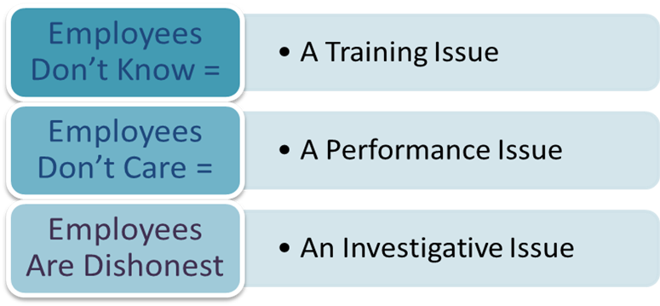
Ingredient 4 (cont.)
Developing an Audit Program to validate and monitor Compliance
An audit program provides a compliance snapshot of each location. Recognizing non-compliance is the first step in understanding the cause of potential loss.
What you find from your audits can point you to the proper resolution.
In the development of an audit program, it is best to divide auditing into smaller components so that scores are not skewed and clearly indicate the area of concern.
Operational Compliance to Policy & Procedure
Food Safety
Physical Safety & Security

Slide 10
Ingredient 4 (cont.)
A comprehensive audit program will also provide actionable information when a potential investigation is required. Unfortunately, employee theft is an actual occurrence in the food service environment. Here are some of the critical elements to remember when it comes to proper and successful investigation programs.
Utilize Your Employees
Utilize a “business abuse” reporting hotline (voicemail boxes are not recommended) to gather information from your employees. The best information is often provided by those that see/hear something.
Protect Your Employees
Clear protocols should exist that outline the communication responsibilities and response to reported or suspected issues of dishonesty.
Document & Write It Down
Document your protocols for the different types of investigations such as theft, narcotics usage, harassment and “post- incident” issues like robberies or safety issues.
Have the Right People Investigate
Investigations should be conducted by trained and certified personnel to reduce liability and properly control the situation.
Investigate Consistently & Completely
Guidelines should be developed that provide consistent practices in completing investigations, report writing, restitution, prosecution and confidentiality.

Slide 11
Ingredient 5: Education & Training
“When people know better, they do better”
The best tool for reducing loss and improving performance is an educated staff. An effective loss prevention program provides the training to ensure that every employee is equipped with the information needed to prevent loss.
A training and awareness program should include;
Training specific programs for management and employees –both location-based and corporate personnel
New Hire orientation program to on-board employees with a basic understanding of loss prevention in the food
service environment
Regular (monthly is best), written materials to provide information and awareness to keep loss prevention “top of mind”
A schedule of in-store training sessions for those target locations that need additional awareness to conform to
company standards

Slide 12
The Next Step in Your Recipe for Loss Prevention Success
“You can’t build a reputation on what you plan to do…only on what you do”
A comprehensive loss prevention program starts with the right “ingredients” and should follow up with the clear “recipe” that includes your goals, objectives and steps to completion.
To begin taking the next steps and determine your goals, answer these questions…
Where are the opportunities to decrease our losses, food costs and risks?
Are we being proactive in trying to prevent and mitigate risk and loss?
Do our employees know their role in preventing loss and do we provide them with the training to understand how to prevent loss?
What practices do we need to develop from scratch? Could we use assistance in the development of these
components?

Slide 13
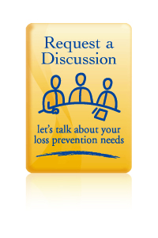
About The Integritus Group
The Integritus Group, Inc. is a leader in loss prevention outsource solutions and services across the United States and Canada.
The Integritus Group helps companies build comprehensive and proactive loss prevention programs that deliver results. The Integritus Group is more than just trusted experts and consultants; We provide the field and corporate personnel that build and execute loss prevention services and solutions.
Our value proposition is simple. We provide our clients with:
Proven loss prevention strategies and results
Expert field personnel for a successful loss prevention program
The ability to quickly develop, implement and execute a new loss prevention function (complete outsourced model)
Supplement an existing loss prevention department with additional resources that are less costly than adding headcount.
Cost effective programs
No long term contracts
The Integritus Group has designed and executed programs with results that exceed expectations.
We invite you to learn more about The Integritus Group and the benefits of our expert solutions
and services.
VISIT OUR WEBSITE

Slide 14
An Educational Presentation by

